Slide 1
RISC-V Open Hours (2023-July-13)
Please request edit to make additions or corrections.
What is RISC-V Open Hours?
Bi-weekly meetup to provide the opportunity for the community to interact in real-time, with a particular focus on RISC-V support in open source software projects and RISC-V dev boards
Call for participation is open! No prepared talk or slides required
Today: Thursday, July 13, 2023, 10:00 – 11:00 AM GMT+8
https://www.youtube.com/@RISCVInternational/videos
Next open hours: July 26, 2023 at 11:00 PM GMT+8.
RISC-V Ambassadors in attendance
Akira, Drew Fustini, Ji Qiu, Wei Wu, Wei Fu

Slide 2
How to get involved with RISC-V International?
The organization that develops the RISC-V specifications: riscv.org
community.riscv.org/events
Non-profit with 3,100 + members across 70 countries including companies and universities
Become a member - free of cost to individuals and non-profits
RISC-V wiki has many helpful resources
RISC-V mailing lists for many topics (public archives)
Technical Meetings Calendar
Notes:
22 Premier Members
181 Strategic Members
140 Community Organization Members

Slide 3
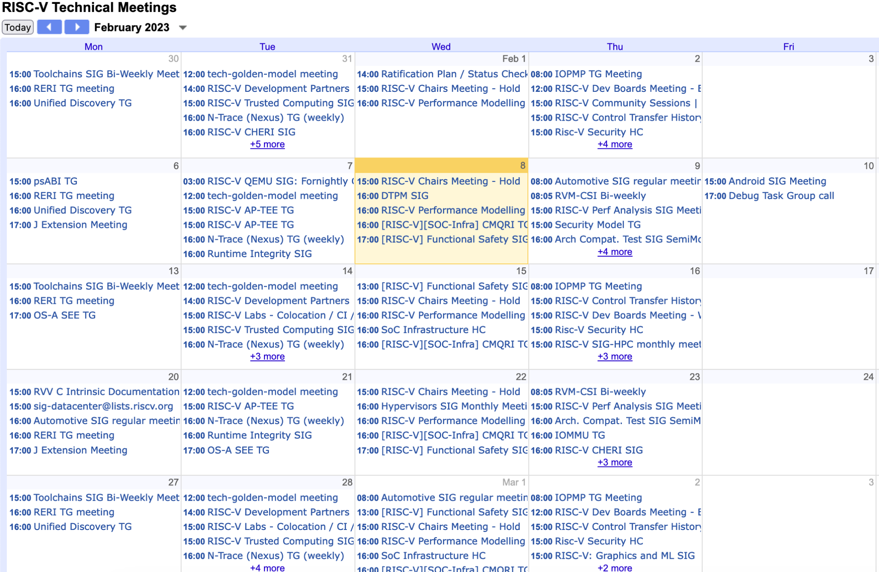
https://calendar.google.com/calendar/u/0/embed?src=tech.meetings@riscv.org

Slide 4
RISC-V Developer Boards
Initiative to get boards into the hands of open source developers
Blog post: ”Announcing RISC-V International’s Expanded Developer Boards Program”
Fill out the application
Need to be RISC-V International member (or part of a member organization), but remember that individuals can join RISC-V International free of cost
Explain why you are interested in RISC-V and what you plan to do with dev board
To improve your chances, don’t overestimate your hardware requirements like RAM

Slide 5
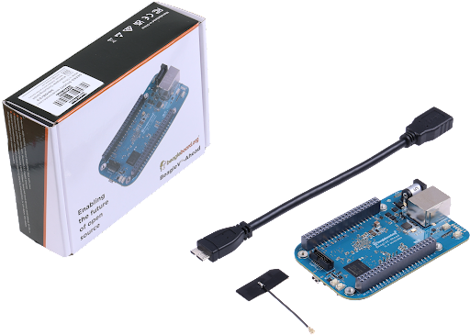
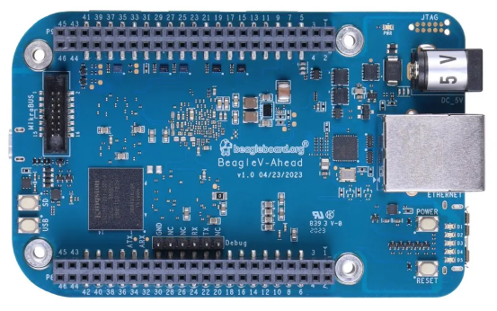
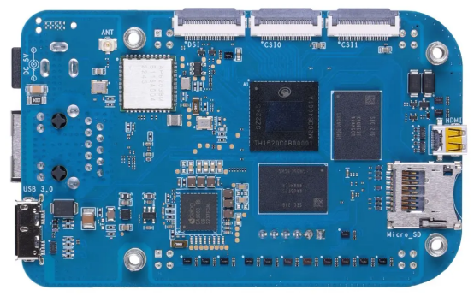
BeagleV Family
BeagleV-Ahead RISC-V computer from
BeagleBoard.org available now under $150
This is the main BeagleBoard documentation.

Slide 6
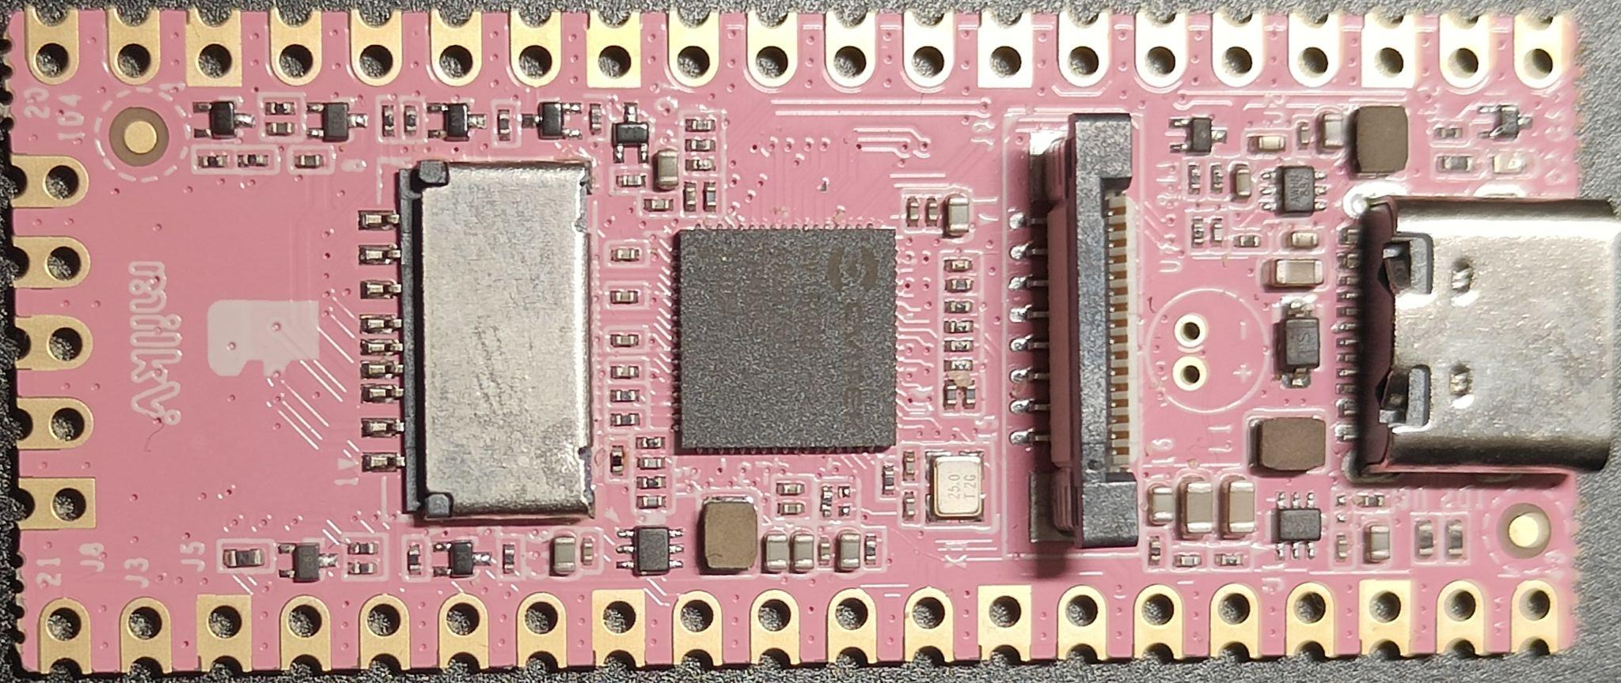
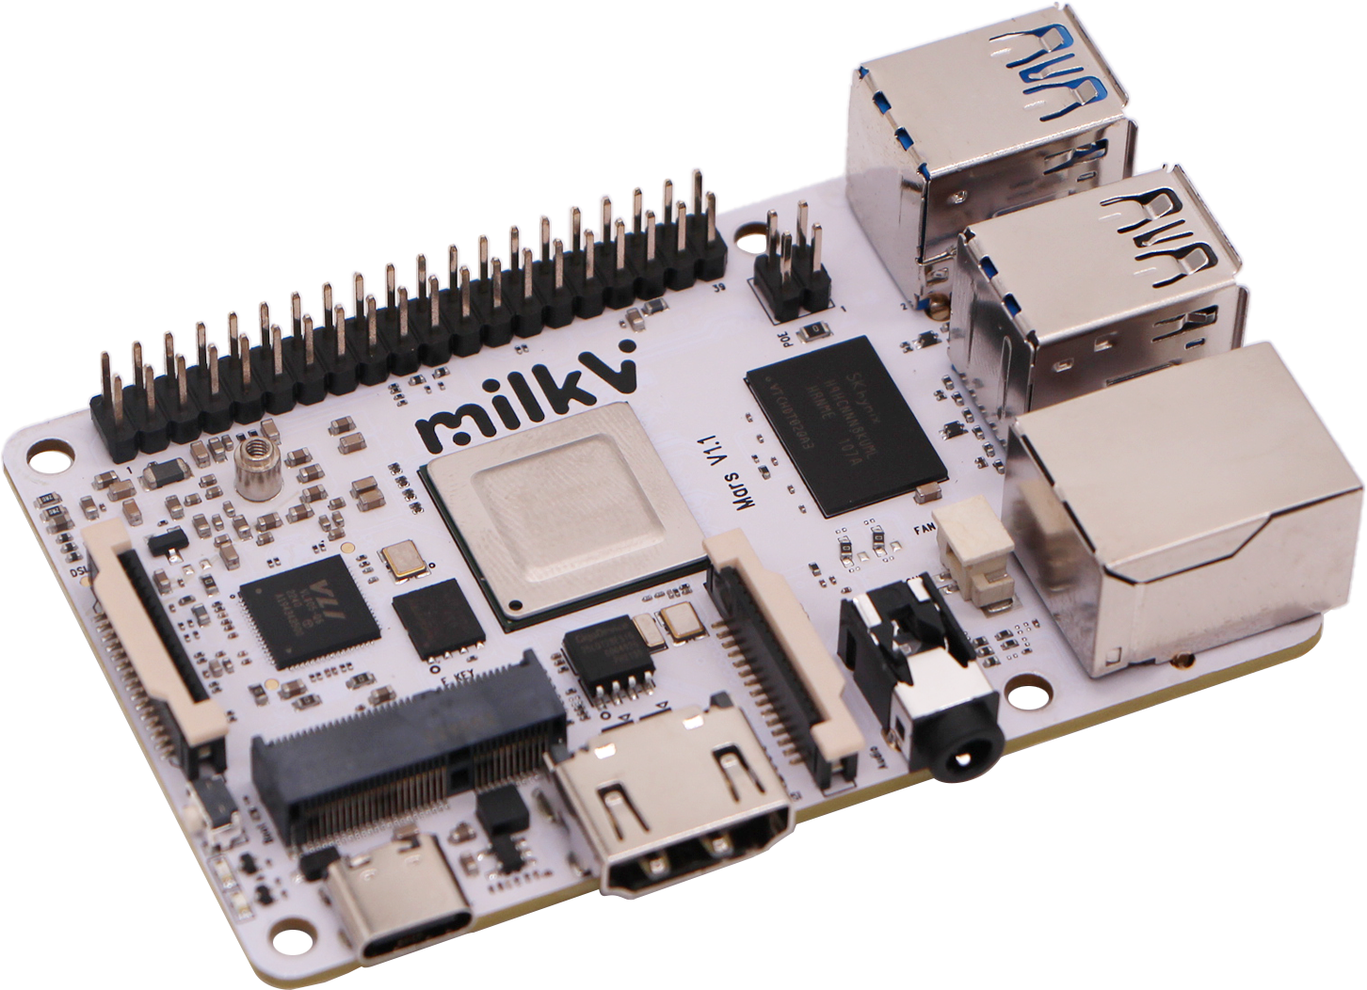
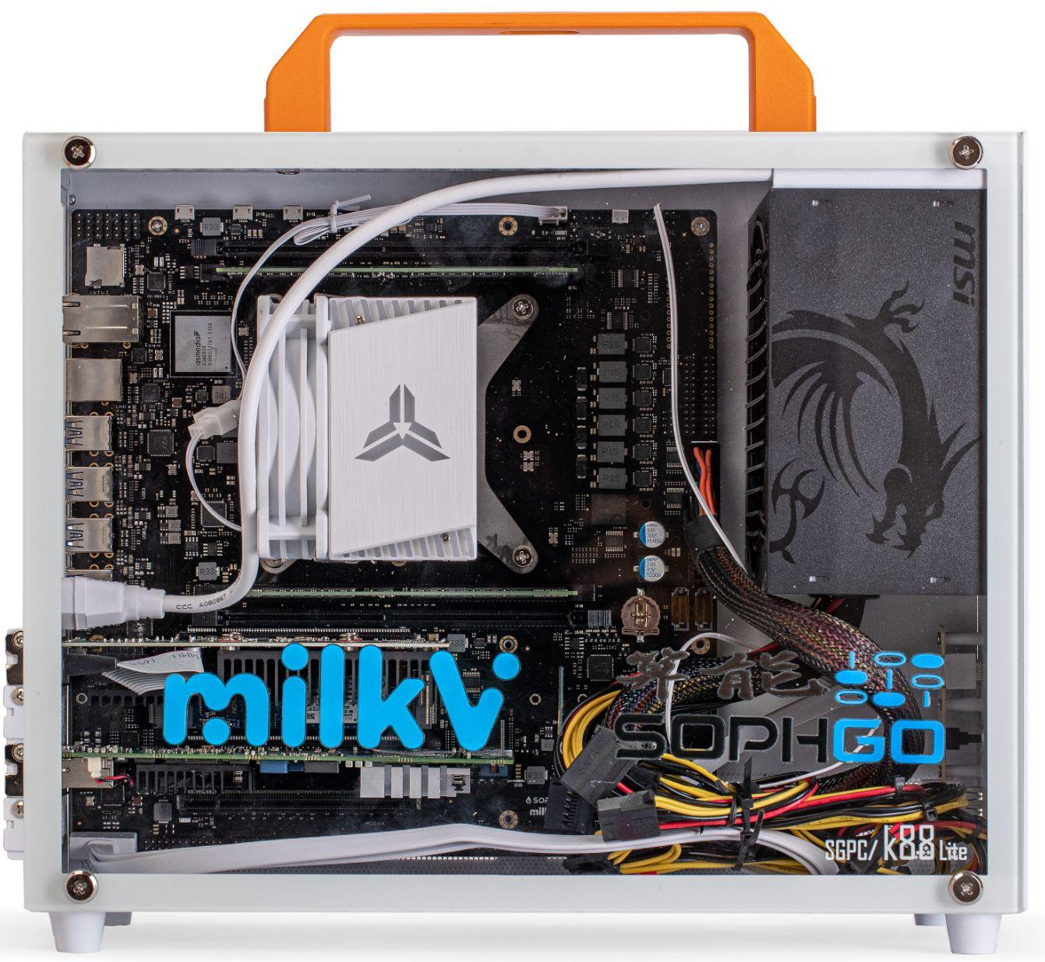
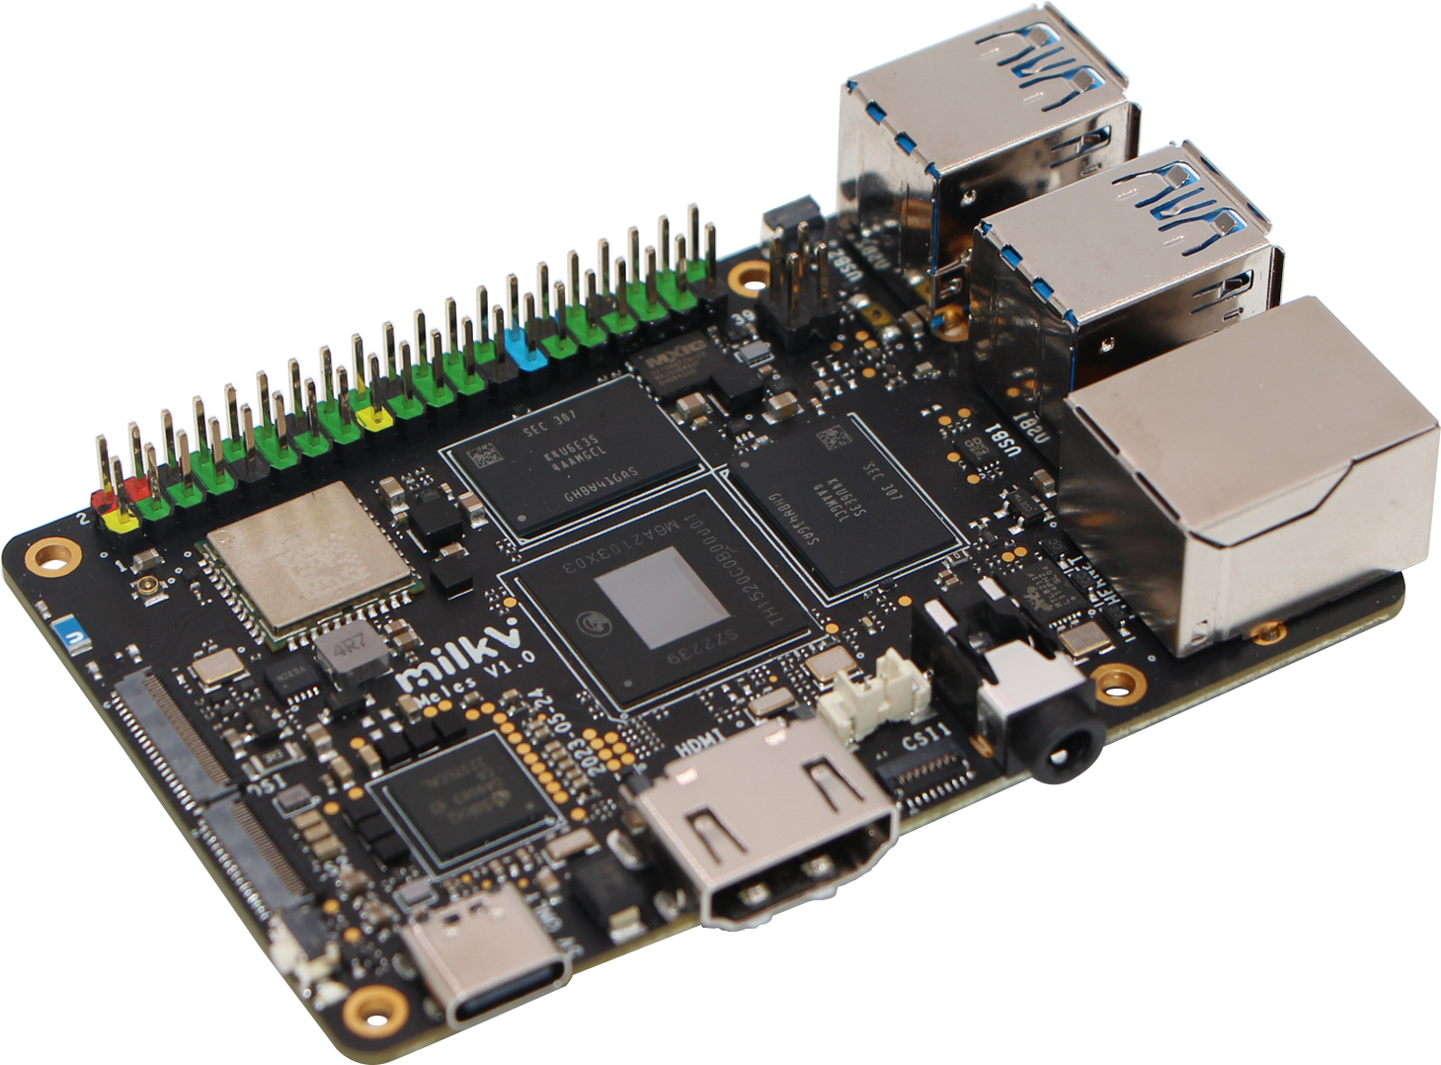
Milk-V Family
Duo [CV1800B]
Mars [JH7110]
Pioneer[SG2042]
Meles[TH1520]

Slide 7
Fedora for RISC-V status update（20230713）
Desktop support:
DONE：XFCE/LXDE/LXQT/GNOME/ Budgie/Cinnamon/Mate/Sugar/Sway/KDE
Building：Deepin
Key Desktop App
firefox-115.0-1[DONE]
Libreoffice 7.5.3.2-2[DONE]
Thunderbird 102.12.0[DONE]
Chromium [ONGOING]
Image :
Sophgo SG2042 EVB/Milk-V[DONE]
zsbl→opensbi->edk2→GRUB→Fedora
TH1520 BeagleV/LPi4A/***[DONE]
StarFive JH7110 boards[ONGOING]
ROS/ROS2 upgraded to F38
ROS2 packaging is ongoing
function testing:
Podman[pass]，Image：fedora-rv64
Ceph[pass]
K8s [pass][tested by Sophgo]
RPM packaging
Status: Updating Fedora 38
20442/23064 [88.63%] srpm have been built.
Spin: Server/Workstation/Cloud
WIP Spin: IoT/CoreOS [ONGING]
main package version:
Toolchain(up-to-date for F38)
gcc-13.1.1-4[DONE]
glibc-2.37.4[DONE]
Binutils 2.39-12[DONE] → 2.40-10 [ONGING]
libffi-3.4.4-2(up-to-date)
java-latest-openjdk-19.0.2.0.7→20 [ONGING]
perl-5.36.1-497(up-to-date)
Python 3.11.4-1(up-to-date) → 3.12
LLVM/Clang 16.0.4-1(up-to-date)
golang-1.20.5-1(up-to-date)
rust-1.70.0-1(up-to-date)

Slide 8
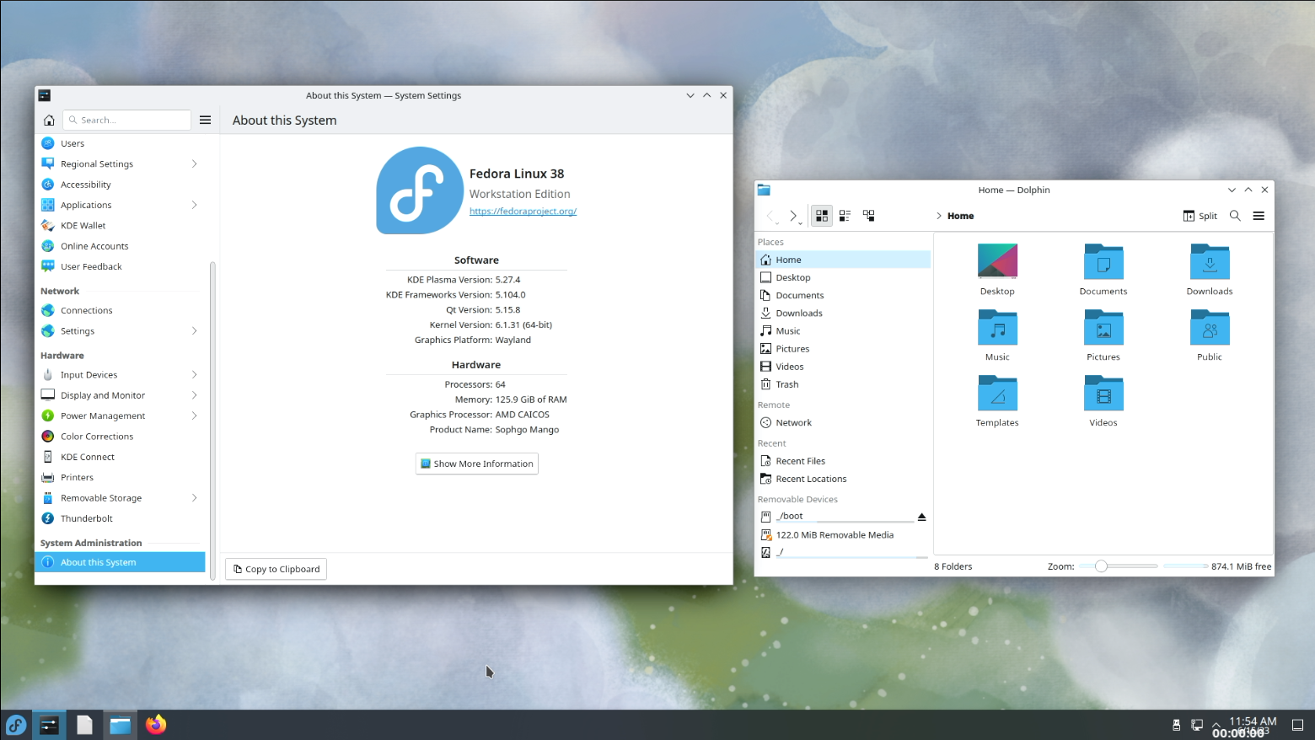
Fedora 38 KDE desktop on Milk-V

Slide 9
Fedora for RV32 （20230713）
Create a new bootstrap framework, target on multi-arch rpm-based Linux distro bootstrap
https://github.com/fedora-riscv/bootstrap
Download srpm automatically by a given list
https://github.com/fedora-riscv/srpm-get
Automated build script using yaml
https://github.com/fedora-riscv/rpm-builder
All the documents for this bootstrap
https://github.com/fedora-riscv/bootstrap-development-log
https://github.com/fedora-riscv/rpmbuild-fedora-log
The current status of bootstrap: stage4 building rpm for minimal rootfs，135/146[92%]。
PR:
rpm
gmp
annobin
Cross build
Stage3: native build
packging tools: rpmbuild
Stage1: Native toolchain build
Stage2: minimal rootfs (with make)
Stage6: koji Image builder rpms
Stage4: (rpm installed)
minimal rootfs
Stage5: koji rpm builder rpms

Slide 10
AOSP for RISC-V (Chen Wang)
Google upstream work，major progress since last meeting：
The Android build system has added support for Zbb/Zba/Zbs, "-march=rv64gc_zba_zbb_zbs", the test results seem to have no effect on the original system.
The ART part continued to progress, we can see most patches are about ART since last week, most patches are to improve the JNI compiler.
The binary_translation project is still by far the second most active project besides ART.
Emulator cuttlefish, add angle to cf's image.
RVI Android SIG work
Continue on landing patches about Chromium into mainline upstream.
Kick-off work to optimize media codec libraries, such as libvpx.
More PRs and technical notes contribution from ISCAS since last meeting share(in Chinese): https://github.com/isrc-cas/tarsier-monthly/blob/main/009-20230701.md#aosp

Slide 11
RISC-V GCC progress (Jiawei)
Zvfh extension intrinsic API is supported in GCC: Support RVV FP16 ZVFH floating-point intrinsic API
Support lga pseudo-instruction to expand the GOT access: Add lga assembler macro support
Atomic ABI is still under discussing: Define new tag for atomic ABI
Updated RISC-V Profiles format define with BNF in toolchain: Add RISC-V Profiles format
RVV auto-vec support still WIP: RVV auto-vectorazition recently commits
Vector crypto extensions Zvk* supported in GNU toolchain: Vector crypto gcc commit
Rebased Zc* extension binutils patches: Support Zca/f/d extensions
CORE-V planning to send their vendor extension Xcv* work to GCC upstream:cv32e40p
RISC-V GNU toolchain meeting slides links: 06-15 06-29

Slide 12
Arch Linux for RISC-V (Pan Ruizhe)
https://github.com/felixonmars/archriscv-packages
RISC-V Days 2023 @ Tokyo:
Slides http://riscv.or.jp/wp-content/uploads/Arch-Linux-RISC-V.pdf
Poster https://riscv.or.jp/wp-content/uploads/An-Introduction-to-the-Arch-Linux-RISC-V-Port-and-Related-Works.pdf
Sophogo machine booted successfully, and has been used as building machine and development machine
Highlight Works:
Binutils bug (cherry picked unreleased commits) https://github.com/felixonmars/archriscv-packages/pull/2770
ld mistakenly adds dynamic TLS reloc, which causes relocation issue & systemd complains relocation found in ELF file, such as /usr/lib/systemd/systemd-logind
Chromium 114
Electron 22 (test build) https://github.com/kxxt/archriscv-packages/tree/electron22
OpenSUSE build is not useable at all, due to some functions missing rv64 implementation
e.g. CrashPad. So we added the missing parts
Current status: qemu-user build segfault; native build on board function correctly under a specific environment. Still investigating
Code OSS https://github.com/felixonmars/archriscv-packages/pull/2791
Systemd seccomp: add riscv_hwprobe to @default https://github.com/systemd/systemd/pull/28307
Linux: riscv: entry: set a0 prior to syscall_handler (waiting for review)
https://patchwork.kernel.org/project/linux-riscv/patch/20230711062202.3542367-1-CoelacanthusHex@gmail.com/
This patch fixes kernel >= 6.4: sudo not functioning in systemd-nspawn

Slide 13
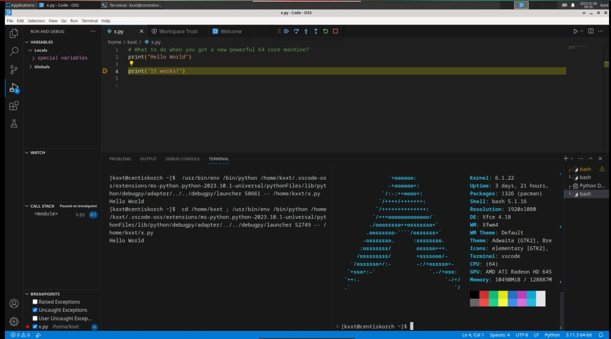
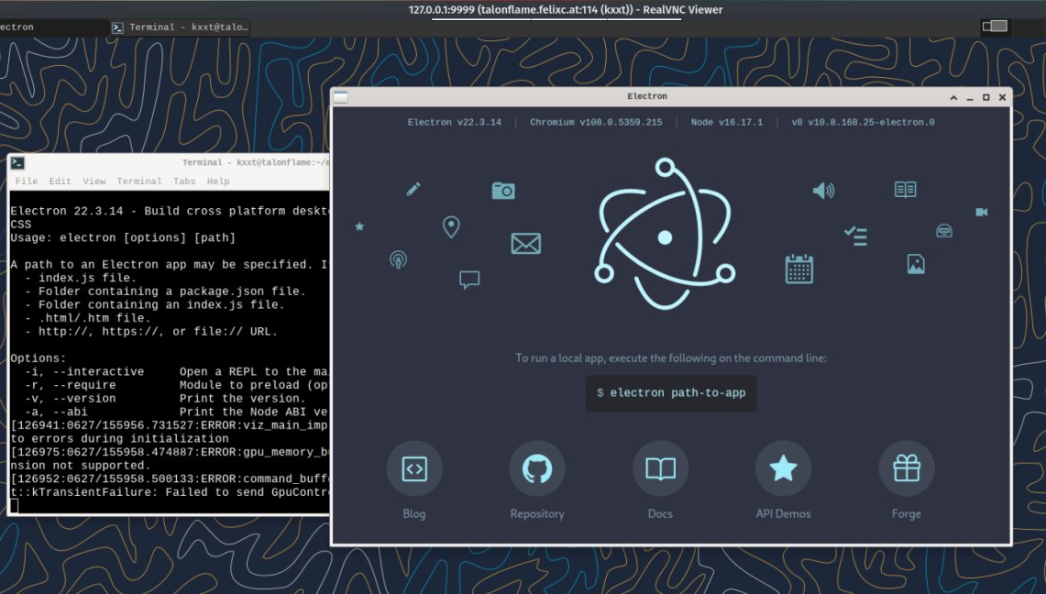
Arch Linux for RISC-V (Pan Ruizhe) (cont.d)
Electron and Code OSS on Arch Linux RISC-V demonstration:
Terminal, code highlights & language servers, code editing, code server, debugging

Slide 14
Debian Linux for RISC-V (YU BO)
Official port update: No update.
Debci: update for July
Some works: 1. Rebased firefox 114, 115.0.2 is building 2. ffcall support riscv64 #1038803
3. tcc enable build for riscv64 #1040217 4.Debian riscv64 kernel support BTF
5. Debian rv32 (sbuild works,but harder issues need to fixed)

Slide 15
openEuler RISC-V（Zhou Jiacheng）
Preparing the next release 23.09, when RISC-V will be officially supported by openEuler
Sending RISC-V related changes upstream to distro mainline
Expanding test breadth and depth according to distro guidelines
Approaching milestones of the “LLVM Parallel Universe Project”, preliminary performance test ongoing
Some works
kernel: evaluating upgrading to 6.4 [open]
crash: backport riscv64 enablement patch [merged]
ceph: fix packaging issue for riscv64 [open]
openblas: fix packaging issue for riscv64 [merged]
libjpeg-turbo: add riscv64 packaging changes [merged]
Many other packaging changes, and more fixes for the “LLVM Parallel Universe Project”

Slide 16
openEuler RISC-V（Duplicate, NOT for the show）
Early preparing for openEuler 23.09, the next release
Approaching milestones of the “LLVM Parallel Universe Project”
Some work
gcc: Backport inline subword atomic patches from gcc 14 [merged, midstream]
mesa: upgrade (21.3.1 -> 23.0.3) [open]
nodejs upgrade (16.15 -> 18.16) [open]
rust: upgrade (1.69.0 -> 1.70.0) [open]
bazel: riscv64 patch applied [open]
Many KDE & Qt6 packages initialized
Many other packaging changes
Tons of packaging and compiling param fixes for the “LLVM Parallel Universe Project”

Slide 17
Fedora for RISC-V status update
RPM packaging
Status: Updating Fedora 38
19320/23118 [83.6%] srpm have been built.
Spin: Server/Workstation/Cloud
WIP Spin: IoT/CoreOS
main package version:
Toolchain(up-to-date for F38)
gcc-13.1.1-2[DONE]→13.1.1-3[rawhide]
glibc-2.37.4[DONE]
Binutils 2.39-12[DONE] → 2.40-7[rawhide]
libffi-3.4.4-2(up-to-date)
java-latest-openjdk-19.0.2.0.7→20 [ONGING]
perl-5.36.1-497(up-to-date)
Python 3.11.3-2(up-to-date) → 3.12[building]
LLVM/Clang 16.0.4-1(up-to-date)
golang-1.20.4-1(up-to-date)
rust-1.70.0-1(up-to-date)
Desktop appreciation
firefox-114.0-1[DONE]
Libreoffice 7.5.3.2-2[DONE] MOCK
Thunderbird 102.10.0[DONE]
Chromium-113.0.5672.63 [ONGING]
Image :
Sophgo SG2042 EVB/Milk-V[DONE]
zsbl→edk2→GRUB→Fedora
TH1520 BeagleV/LPi4A/***[DONE]
StarFive JH7110 boards[Coming soon]
ROS/ROS2 upgraded to F38
Desktop support:
DONE：XFCE/LXDE/LXQT/GNOME/ Budgie/Cinnamon/Mate/Sugar/Sway
Building：KDE/Deepin
Server appreciation :
Podman[pass]，
Container Image：fedora-rv64
Ceph[pass]
K8s [pass][tested by Sophgo]

Slide 18
Fedora for RV32
investigate the Fedora bootstrap scripts for aarch64，try to improve it for RV32:
https://github.com/U2FsdGVkX1/Fedora_bootstrap
create a new bootstrap framework, target on multi-arch rpm-based Linux distro bootstrap
https://github.com/fedora-riscv/bootstrap
Download srpm automatically by a given list
https://github.com/fedora-riscv/srpm-get
All the documents for this bootstrap:
https://github.com/fedora-riscv/bootstrap-development-log
https://github.com/fedora-riscv/rpmbuild-fedora-log
The current status of bootstrap: stage3 native build，135/146[92%]。
Cross build
Stage3: native build
packging tools: rpmbuild
Stage1: Native toolchain build
Stage2: minimal rootfs (with make)
Stage6: koji Image builder rpms
Stage4: (rpm installed)
minimal rootfs
Stage5: koji rpm builder rpms

Slide 19
Clang/LLVM + RISC-V
[RISCV] Match shl_vl (ext_vl v, splat 1) to vwadd_vl https://reviews.llvm.org/D154726
[ValueTracking] Guaranteed well-defined if parameter has a dereferecable_or_null attribute https://reviews.llvm.org/D153945
[SCCP] Replace valuestate.isConstant with helper isConstant https://reviews.llvm.org/D153717
[InstCombine] Add !noundef to match behavior of violating assume https://reviews.llvm.org/D153400
[MemoryDependencyAnalysis] Delete cache infos if CacheInfo->size != Loc.size https://reviews.llvm.org/D154323

Slide 20
QEMU and Spike Progress
QEMU
Update support for BF16
https://lists.gnu.org/archive/html/qemu-riscv/2023-06/msg00377.html
Improve PMP check
https://lists.gnu.org/archive/html/qemu-riscv/2023-06/msg00730.html
Add RISC-V TCG support for V extension
https://github.com/plctlab/plct-qemu/tree/plct-riscv-backend-rvv
Spike
Fix disas for cm.mva01s/mvsa01
https://github.com/riscv-software-src/riscv-isa-sim/pull/1372
Fix lmul range
https://github.com/riscv-software-src/riscv-isa-sim/pull/1403

Slide 21
V8 for RISC-V （from PLCT, regular daily maintain）
1. Port upstream
4576325: [riscv][builtins] Split CallApiCallback into generic and optimized variants | https://chromium-review.googlesource.com/c/v8/v8/+/4576325
4593016: [riscv][wasm-gc] Inlining into JS: Lower traps to conditional jump to trap call | https://chromium-review.googlesource.com/c/v8/v8/+/4593016
4583609: [riscv] Fix pointer compression | https://chromium-review.googlesource.com/c/v8/v8/+/4583609
4596402: [riscv][simulator] Fix test error of vfwredosum in riscv32 | https://chromium-review.googlesource.com/c/v8/v8/+/4596402
4606688: [riscv][builtins] Port HandleApiCall to CSA | https://chromium-review.googlesource.com/c/v8/v8/+/4606688
4608527: [riscv][heap] Move age from BytecodeArray into SharedFunctionInfo | https://chromium-review.googlesource.com/c/v8/v8/+/4608527
4612048: [riscv][compiler] Add Adapter template argument to InstructionSelector | https://chromium-review.googlesource.com/c/v8/v8/+/4612048
4624977: [riscv][SFI] Fix the store size of SharedFunctionInfo::Age field | https://chromium-review.googlesource.com/c/v8/v8/+/4624977
4630556: [riscv][compiler] Generalize InstructionSelectorT for Turboshaft (part 1) | https://chromium-review.googlesource.com/c/v8/v8/+/4630556
2. New feature
4653674: [sandbox][riscv] Port sandbox | https://chromium-review.googlesource.com/c/v8/v8/+/4653674

Slide 22
Spidermonkey for RISC-V:
No update

Slide 23
OpenJDK Upstream for RISC-V（RV64/PLCT）
1. Reviewed OpenJDK mainline PRs:
- https://github.com/openjdk/jdk/pull/11996 (JDK-8299229: [JVMCI] add support for UseZGC)
- https://github.com/openjdk/jdk/pull/13794 (8303153: Native interpreter frame missing mirror)
- https://github.com/openjdk/jdk/pull/13771 (8307058: Implementation of Generational ZGC)
- https://github.com/openjdk/jdk/pull/13645 (8291550: RISC-V: jdk uses misaligned memory access when AvoidUnalignedAccess enabled)
- https://github.com/openjdk/jdk/pull/13684 (8306966: RISC-V: Support vector cast node for Vector API)
- https://github.com/openjdk/jdk/pull/13739 (8307150: RISC-V: Remove remaining StoreLoad barrier with UseCondCardMark for Serial/Parallel GC)
- https://github.com/openjdk/jdk/pull/13800 (8307446: RISC-V: Improve performance of floating point to integer conversion)
- https://github.com/openjdk/jdk/pull/13862 (8307609: RISC-V: Added support for Extract, Compress, Expand and other nodes for Vector API)
- https://github.com/openjdk/jdk/pull/13881 (8307651: RISC-V: stringL_indexof_char instruction has wrong format string)
- https://github.com/openjdk/jdk/pull/12682 (8302908: RISC-V: Support masked vector arithmetic instructions for Vector API)
- https://github.com/openjdk/jdk/pull/13245 (8305247: On RISC-V generate_fixed_frame() sometimes generate a relativized locals value which is way too large)
- https://github.com/openjdk/jdk/pull/13244 (8305236: Some LoadLoad barriers in the interpreter are unnecessary after JDK-8220051)
- https://github.com/openjdk/jdk/pull/13079 (8304265: Implementation of Foreign Function and Memory API (Third Preview))
- https://github.com/openjdk/jdk/pull/13368 (8305728: RISC-V: Add test_bit for power-of-two bit mask testing)
- https://github.com/openjdk/jdk/pull/13477 (8300197: Freeze/thaw an interpreter frame using a single copy_to_chunk() call)
- https://github.com/openjdk/jdk/pull/12706 (8306057: False arguments calling dispatch_base for aarch64)
- https://github.com/openjdk/jdk/pull/13227 (8305056: Avoid unaligned access in emit_intX methods if not enabled)
- https://github.com/openjdk/jdk/pull/13345 (8051725: Improve expansion of Conv2B nodes in the middle-end)
2. Reviewed/Merged backport PRs for riscv-port-jdk17u repo:
- https://github.com/openjdk/riscv-port-jdk17u/pull/33 (8305512: RISC-V: Enable RVC extension by default on supported hardware)
- https://github.com/openjdk/riscv-port-jdk17u/pull/34 (8290137: riscv: small refactoring for add_memory_int32/64)
- https://github.com/openjdk/riscv-port-jdk17u/pull/35 (8293474: RISC-V: Unify the way of moving function pointer)
- https://github.com/openjdk/riscv-port-jdk17u/pull/36 (8294430: RISC-V: Small refactoring for movptr_with_offset)
- https://github.com/openjdk/riscv-port-jdk17u/pull/37 (8294492: RISC-V: Use li instead of patchable movptr at non-patchable callsites)
- https://github.com/openjdk/riscv-port-jdk17u/pull/38 (8295270: RISC-V: Clean up and refactoring for assembler functions)
- https://github.com/openjdk/riscv-port-jdk17u/pull/39 (8295968: RISC-V: Rename some assembler intrinsic functions for RVV 1.0)
- https://github.com/openjdk/riscv-port-jdk17u/pull/40 (8293050: RISC-V: Remove redundant non-null assertions about macro-assembler)
- https://github.com/openjdk/riscv-port-jdk17u/pull/41 (8296447: RISC-V: Make the operands order of vrsub_vx/vrsub_vi consistent with RVV 1.0 spec)
- https://github.com/openjdk/riscv-port-jdk17u/pull/42 (8302776: RISC-V: Fix typo CSR_INSTERT to CSR_INSTRET)
- https://github.com/openjdk/riscv-port-jdk17u/pull/43 (8292867: RISC-V: Simplify weak CAS return value handling)
- https://github.com/openjdk/riscv-port-jdk17u/pull/44 (8293524: RISC-V: Use macro-assembler functions as appropriate)

Slide 24
ROCm bootstrapping for RISC-V (Robin Lu, PLCT Tariser)
AMD ROCm™ ROCm is an open software ecosystem for accelerated compute, supporting HPC & machine learning to access open compute languages, compilers, etc
Target: Ubuntu 22.04 LTS (+Kernel Patch), HiFive Unmatched and Vega 7nm
rocm-smi, rocminfo, hipcc, amdgpu, etc. works
rocm opencl runtime meets same problem with https://bugs.gentoo.org/895286 , and rocm-bandwidth-test meets Seg fault.

Slide 25
Open Discussion / AOB
Tarsier Project
More RISC-V events
When will RISC-V be official for Fedora? It needs a RISC-V server to exist.
PLEASE REMOVE THE TEXT BOX IF YOU UPDATED THIS SLIDE

Slide 26
archive & backup

Slide 27
Sophgo is more OPEN, welcome to become our partner.
Sophgo will start a series of open source projects,
will announce them one after another.
Come from Open Source，give back to Open Source。
PLEASE REMOVE THE TEXT BOX IF YOU UPDATED THIS SLIDE

Slide 28
RISC-V Summit in USA
https://events.linuxfoundation.org/riscv-summit/
DECEMBER 13 – 14, 2022 in San Jose, CA

Slide 29
New links from the June 29 discussion
Pine64 update
RISC-V laptop
MNT Reform open source laptop
Rust on RISC-V
Daniel Maslowski works on oreboot
RustSBI: https://github.com/rustsbi
Telegram chat: Mainline Linux for D1 (RISC-V discussions)
PE format has RISC-V listed
IDEs and Debuggers on the RISC-V Exchange (riscv.org)
RISC-V Toolchains and Runtimes sub-committee
Containers and Go applications on RISC-V - Carlos is RISC-V Ambassador
Zoom Transcript from June 29

Slide 30
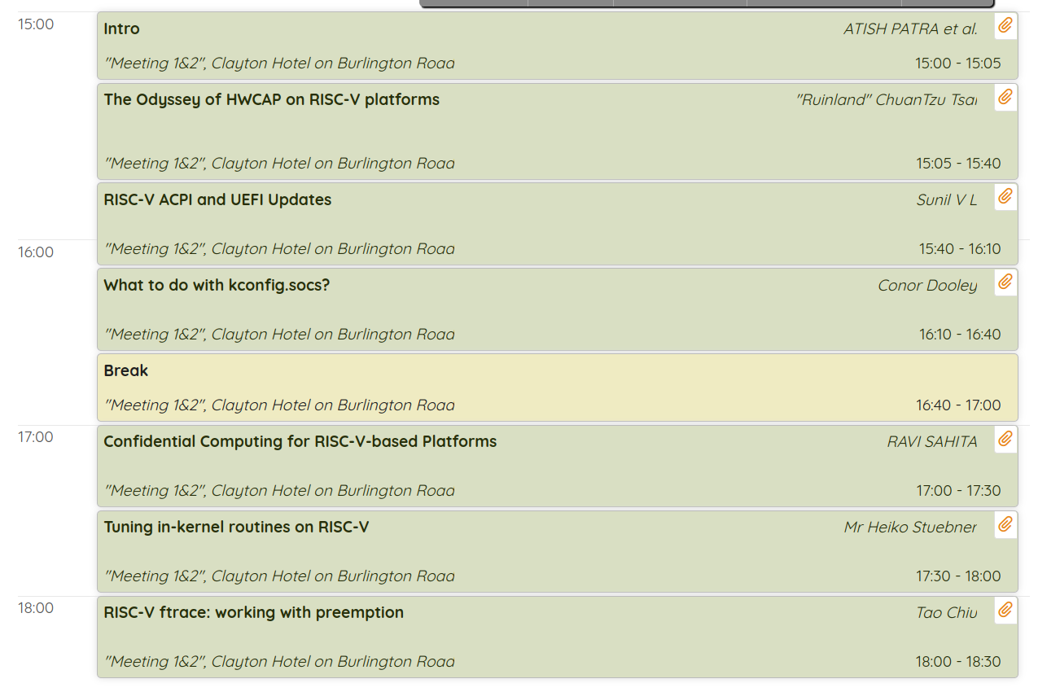
Linux Plumber Conference: RISC-V micro-conference
During Linux Plumbers Conference 2022 in Dublin back in September
Live stream (individual videos of talks posted later)

Slide 31
Embedded Linux Conference Europe 2022
Talks related to RISC-V that happened in Dublin back in September:
Linux on RISC-V by Drew Fustini
RISC-V and Open Hardware BoF (“birds of a feather”) hosted by Drew Fustini
ELC-E Dublin 2022

Slide 32
RISC-V Summit China 2022
All videos are online now: https://space.bilibili.com/1121469705

Slide 33
Linux Distro
Arch Linux
[extra] 2604 / 3035 (85.79%)(up: 0.2%)
[community] 7706 / 9291 (82.94%)( up: 4.83%)
Ported ldc to RISC-V
Debian
New updates for official port, porterbox available
Atomic issue is big problem
openSUSE
https://en.opensuse.org/openSUSE:RISC-V
openEuler RISC-V (oerv)
The new image has been released, adding support for Firefox, Chromium, Libreoffice, Thunderbird, GIMP, VLC and other popular software.

Slide 34
Linux Distro
Gentoo
47 keywordings in the past 4 weeks
firefox/opencl keyworded in official portage tree
Testing systemd’s merge-user profile, so far so good
StarFive donate one VF2 board to Gentoo Community(to @jsmolic)
Gentoo Image for V2 board from community
https://forum.rvspace.org/t/experimental-gentoo-image/1807

Slide 35
RISC-V Day Tokyo 2023 Summer Conference
Schedule and resource：https://riscv.or.jp/en/risc-v-day-tokyo-2023-summer-en/
Event Dates: June 20 (Tue) , 2023 9:00 ‐ 20:00 JST (UTC+9)

Slide 36
RISC-V Lab (2023-04-13) (Wei Wu, Offline)
RISC-V Lab (Beijing) is up and running!
Received 6x EVB/SG2042 boards w/ 64 RISC-V cores! Awesome!
At least 3x boards will be integrated into RISC-V Lab (Hangzhou) for RISC-V developers
Milk-V Pioneer Board (SG2042 Inside) in RISC-V Lab: BEFORE June 3, 2023
RISC-V CI Farm for GCC community - Near finished
6+ Debian, 6+ Ubuntu and openEuler. Deliver to GCC Community Before April, 21, 2023.
PLCT Lab is building a RISC-V Cluster - Building RobinOS for it.
~1024 cores, Nezha/D1 board -> LM4A/TH1520
date to public (plan): Dec 1, 2022→ Dec 31, 2022→April→June 3, 2023?
ISCAS has a few more Unmatched board available! APPLY IT!
Free free to send PRs! https://github.com/plctlab/riscv-lab-access/pulls
PLEASE REMOVE THE TEXT BOX IF YOU UPDATED THIS SLIDE
RISC-V Lab @ Hangzhou

Slide 37
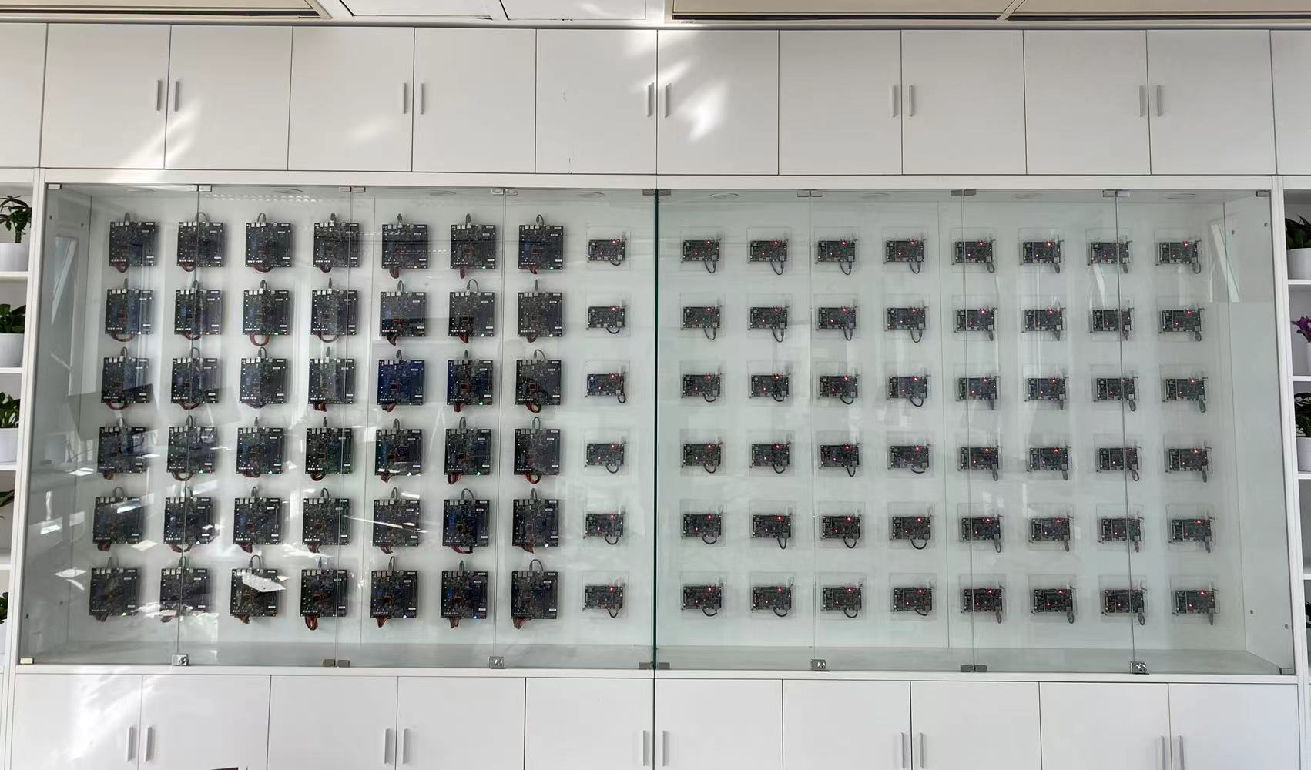
RISC-V Lab (Beijing): Up and Running! All developers are welcome!
Free free to send PRs! https://github.com/plctlab/riscv-lab-access/pulls
PLEASE REMOVE THE TEXT BOX IF YOU UPDATED THIS SLIDE

